Slide 1



Samiha Maisha Jeba
Beta Microsoft Learn Student Ambassador
Competitive Programmer, Academic Mentor, CSE Senior,
bdapps Women Community Leader, AI Enthusiast
International University of Business Agriculture and Technology

Slide 2
Content
Samiha Maisha Jeba
Generation Google Scholarship
Grace Hopper Celebration Scholarship
ICPC Algo Queen
National Girls’ Programming Contest
Quiz Session and Gifts

Slide 3
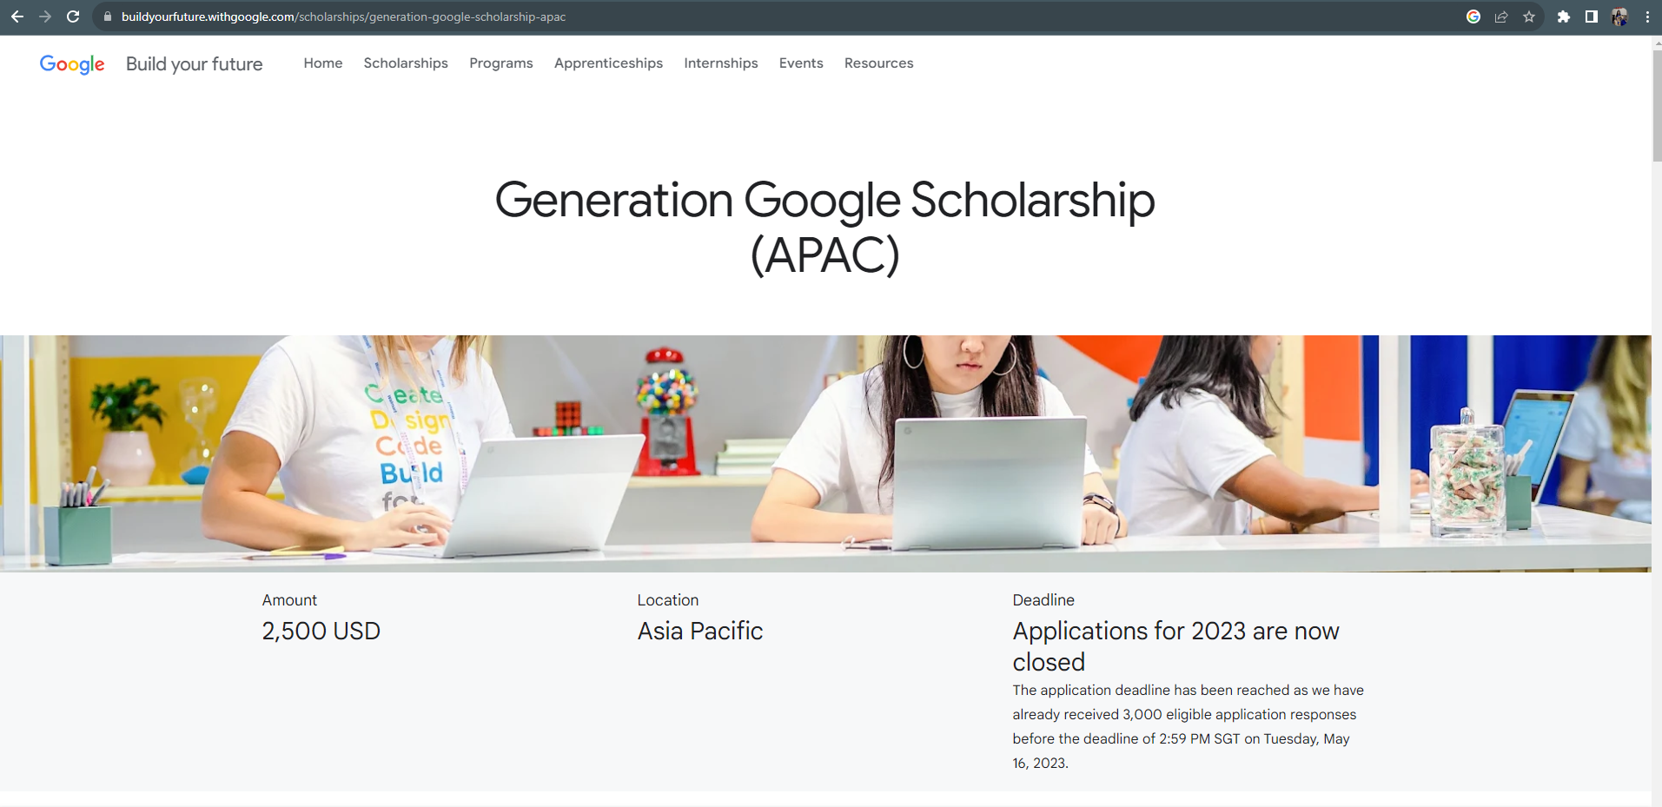
Generation Google Scholarship (APAC)

Slide 4
Generation Google Scholarship (APAC)
Generation Google Scholarship: for women in computer science was established to help students pursuing computer science degrees excel in technology and become leaders in the field.
Awarded on the based on the strength of each candidate's commitment to diversity, equity, and inclusion, demonstrated leadership, and academic performance.

Slide 5
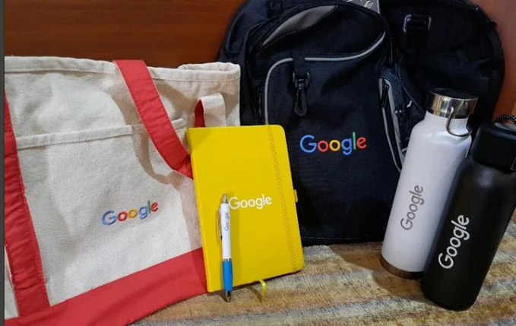
Benefits:
Selected students will receive $2,500 USD
Invited to attend a fully funded retreat at one of Google’s headquarters
Exclusive resources
Personal and professional growth
Selected scholars would be featured on the official Google Website.
Rewarded with the exclusive Google Swag kit

Slide 6
Who can apply?
Full-time second or third year undergraduate student/ First or second year (As per program requirement)
Studying computer science, computer engineering, or a closely related technical field
Demonstrate a strong academic record
Exemplify leadership and demonstrate passion for improving representation of underrepresented groups in computer science and technology

Slide 7
Application process
General background information (e.g. contact information and details about your current and intended universities)
Resume/CV
Academic transcripts from your current institution
Responses to short answer essay questions (The question varies each year)
Online Quiz / Coding Test
Apply Link: https://buildyourfuture.withgoogle.com/scholarships/generation-google-scholarship-apac

Slide 8
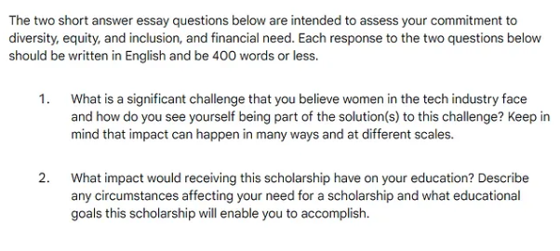
Essay Questions:

Slide 9
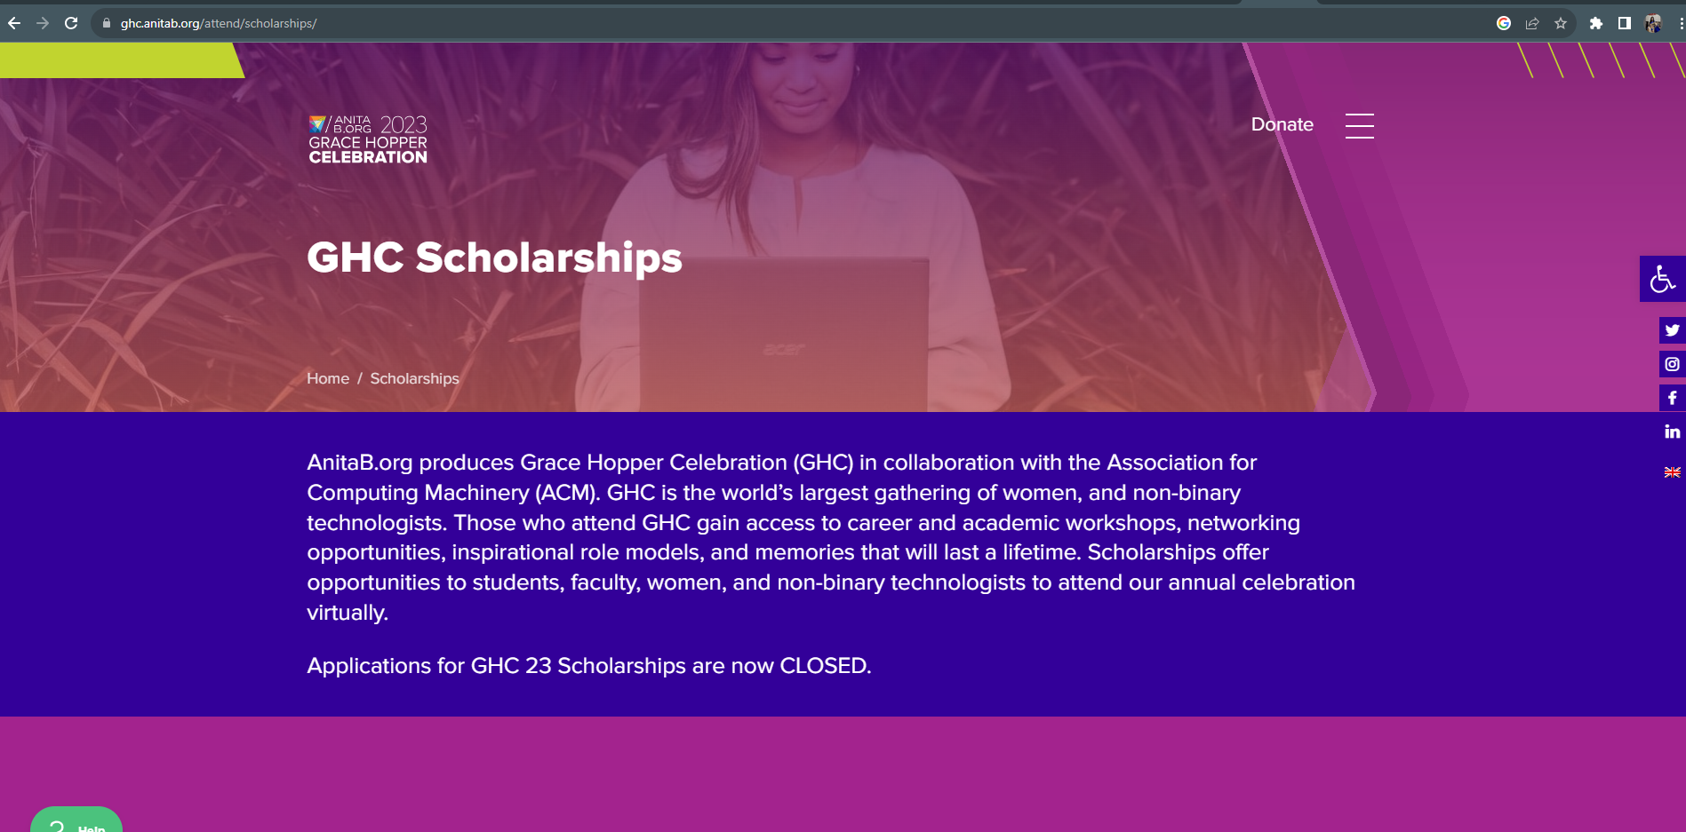
Grace Hopper Celebration Scholarship

Slide 10
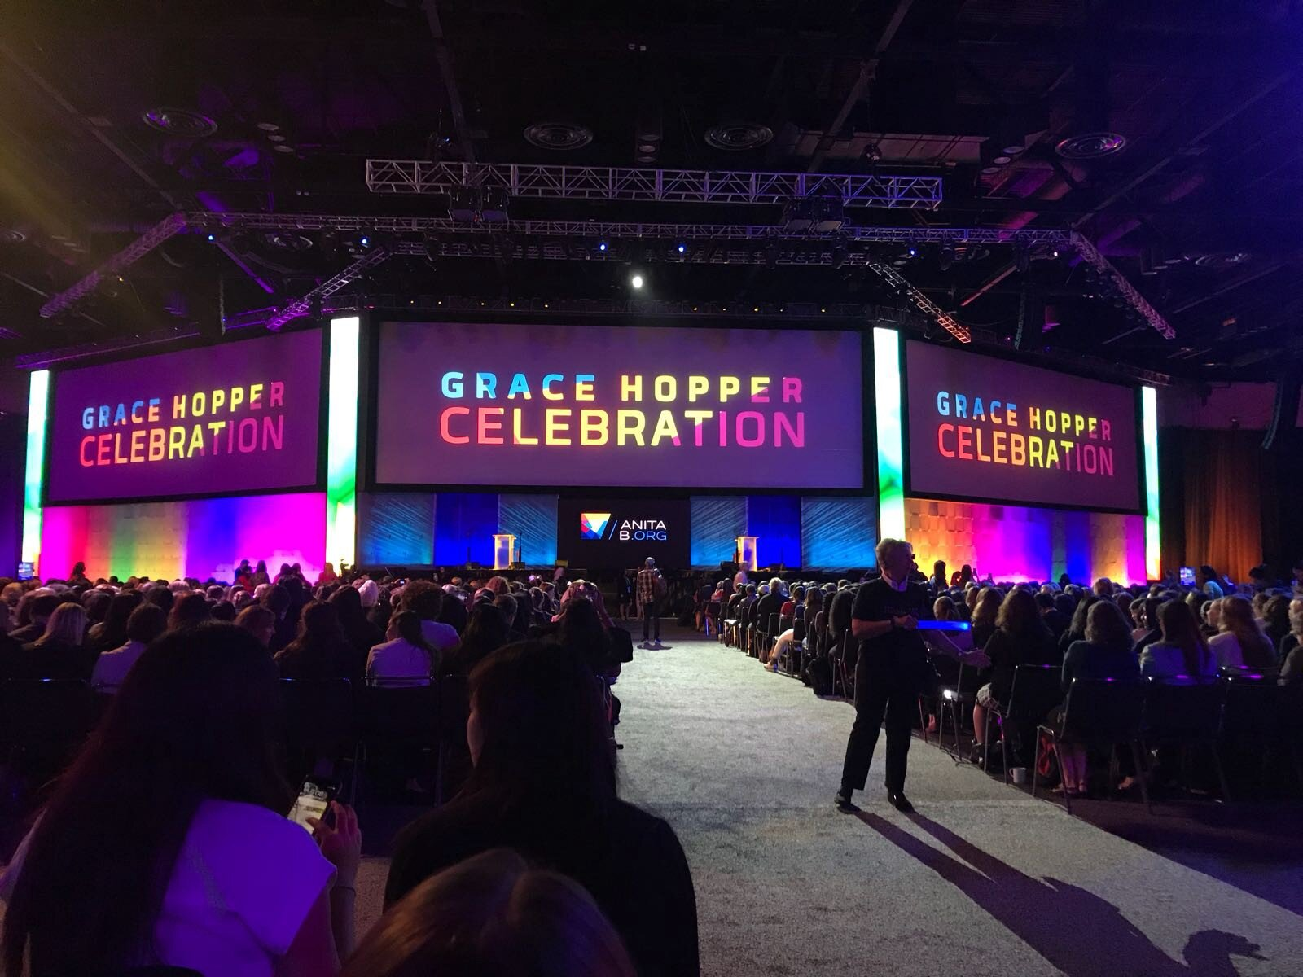
Benefits:
Complimentary GHC 23 virtual registration
Premium AnitaB.org Membership Benefits for 1 year
Networking Opportunities
Access to Mentorship Programs
Academic & Technical Events & Resources
Career Fair Access

Slide 11
Eligibility
Enrolled in an accredited degree program at a higher education institution at the time of the celebration (as per conference day)
You must be at least 18 years of age at the time of the celebration
A minimum cumulative GPA of 2.5.

Slide 12
Application process
General background information
Resume
Responses to short answer essay questions (The question varies each year)
Letter of recommendation
Apply Link: https://ghc.anitab.org/attend/scholarships/student/

Slide 13
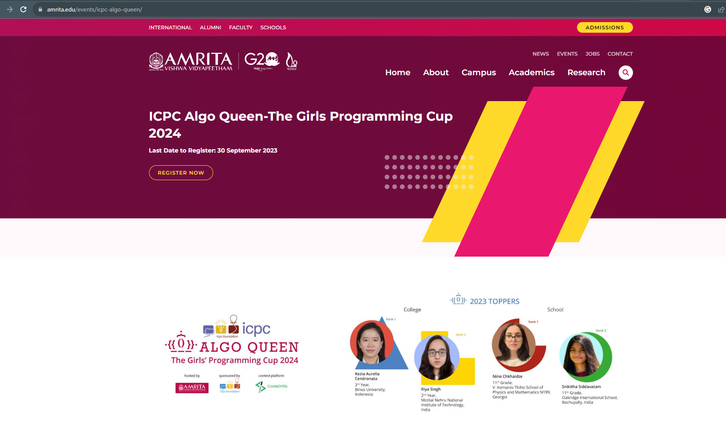
Benefits:

Slide 14
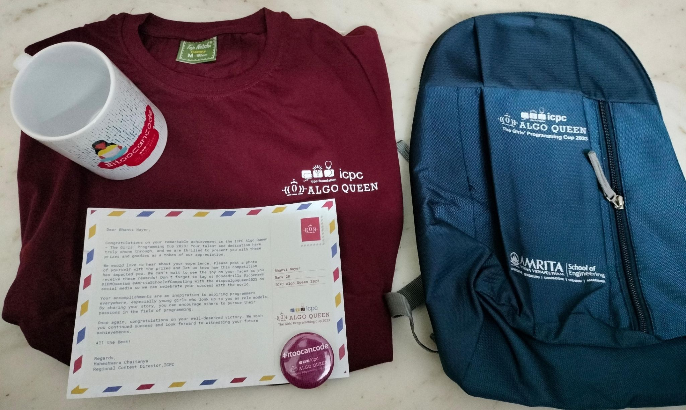
ICPC Algo Queen 2024
Girls only Competitive Programming Contest, as an initiative to encourage girls to participate in Problem Solving and Competitive Programming.

Slide 15

Why Participate?
Exciting Prizes: Participants have the chance to win amazing prizes and be recognized for their coding skills.
Skill Enhancement: Be part of a groundbreaking initiative that encourages you to take on coding challenges and improve your abilities.
Inspiration: Get trained and learn tips and tricks to excel in competitive programming

Slide 16
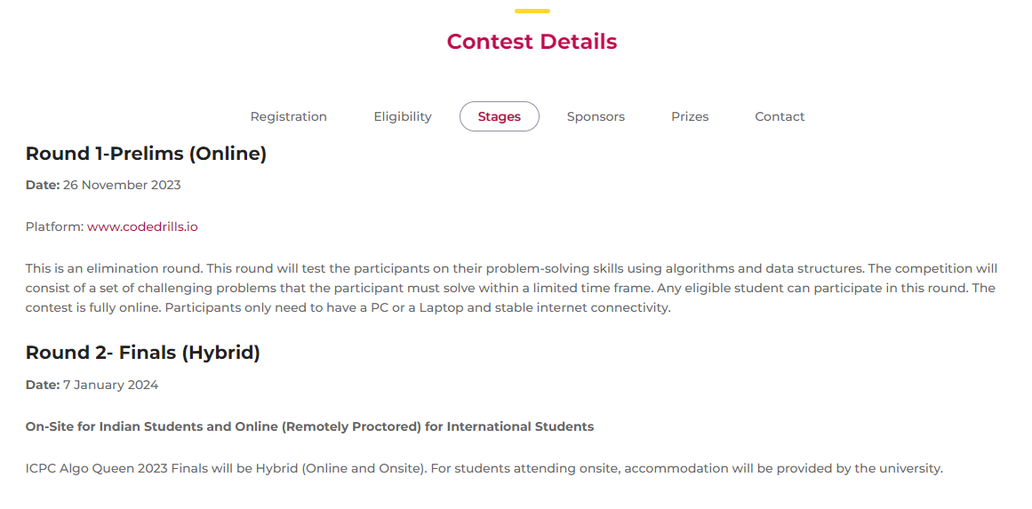
Contest Details
Registration is completely free.
This competition allows only individual participation.
Register Here: https://codedrills.io/contests/icpc-algoqueen-contest-2024?tab=overview

Slide 17
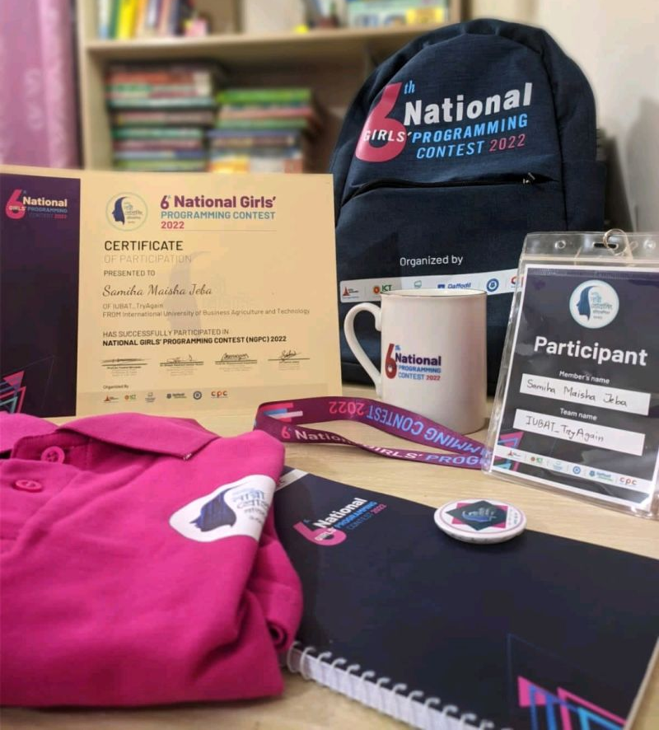
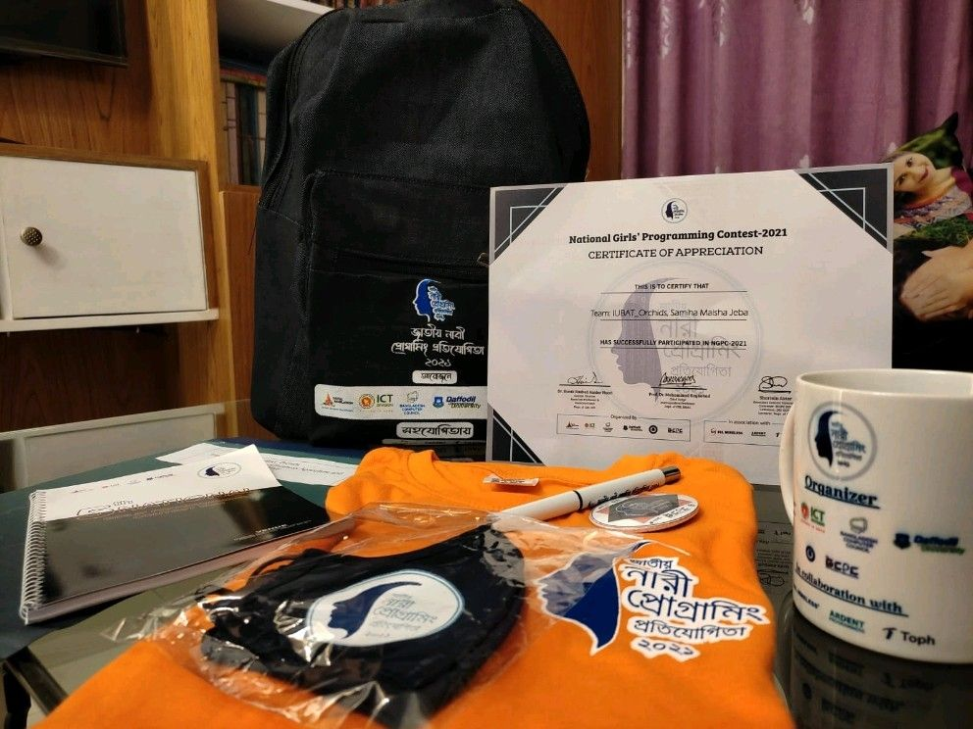
Other Girls’ Contest
National Girls Programming Contest
Ada Lovelace Programming Contest and many more.

Slide 18


Slide 19
Question no 1
Among the following options, which program presents an opportunity to win $2,500 USD?
Generation Google Scholarship
Grace Hopper Scholarship
ICPC Algo Queen
National Girls’ Programming Contest

Slide 20
Question no 2
Among the programs listed, for which one is the application deadline still open?
Generation Google Scholarship
Grace Hopper Scholarship
ICPC Algo Queen
National Girls’ Programming Contest

Slide 21
Question no 3
Among the options provided, which program hosts a Career Fair?
Generation Google Scholarship
Grace Hopper Scholarship
ICPC Algo Queen
National Girls’ Programming Contest

Slide 22
Question no 4
Which programs actively encourages the participation of girls in Problem Solving and Competitive Programming?
Generation Google Scholarship
Grace Hopper Scholarship
ICPC Algo Queen
None of above them

Slide 23
Question no 5
What is the full form of GHC?
Global Hosting Conference
Grace Hosting Celebration
Grace Hopper Conference
Grace Hopper Celebration

Slide 24


Slide 25
Any Question?

